Slide 1
Twitter Influencers
FE 800 A
Final Presentation
Group Members:
Pradeep Adelli
Piyush Arora

Slide 2


Objective
This project is about identifying the people/entities who are influencing a certain business community of interest so that they can be communicated with, more effectively.
For example : Tracking the people/entities who are influencing officers at top positions in Data Analytics industry, such as Chief Analytics Officer, Chief Data Scientist or a Chief Data Officer.

Slide 3
Definitions
An agreed upon definition of “Influence” is currently unavailable. For our purpose, we have used the following definition.
Influence = f (Retweets, Favorites, Mentions, Follow)
Tweet: Any message posted by a user to their Twitter timeline which may contain photos, videos, links and text (up to 140 characters).
Retweet: A Tweet posted by another user that one re-posts to one’s own Twitter timeline.
Mention: A Twitter Handle that one mentions in their tweet.
Favorite: Favorites are the tweets that one has liked in the past.
Follow: When one follows another person on Twitter. Every time a person tweets, it will appear on the feeds of all the people who are following that person.

Slide 4
The Flowchart of Algorithm
Get Search Queries
Extract Twitter Handles
Extract Retweets, Favorites and Mentions
Next Twitter Handle
Aggregate the Scores and get Overall Influencers
Evaluate Score for each influencer

Slide 5
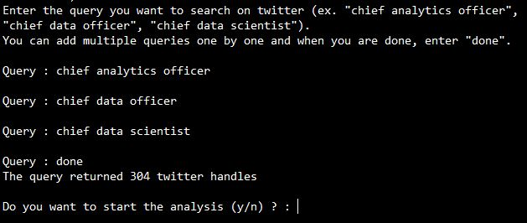
Get Search Queries
Enter keywords which can identify the twitter handles of the target set.
Results are combined for each keyword and a common set is created which is treated as the target set.
Extract Twitter Handles
Extract Retweets, Favorites and Mentions
Evaluate Score for each influencer
Aggregate the Scores and get Overall Influencers

Slide 6
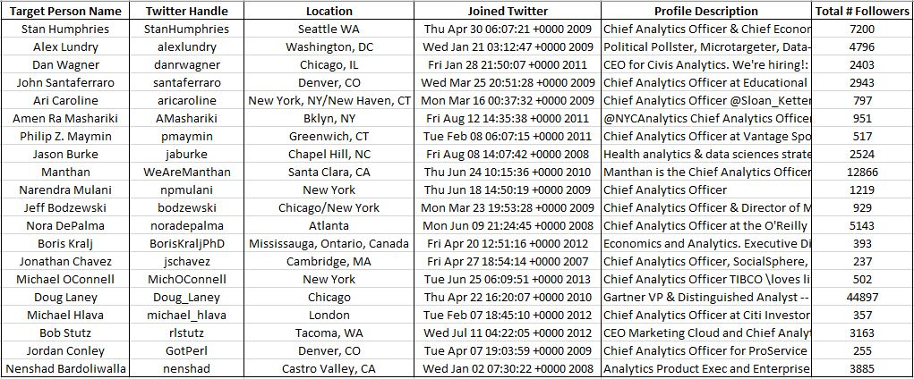
Get Search Queries
The entered keywords are used to search accounts on twitter.
These keywords are searched in the Bio or Profile Description of people.
Below is a screenshot of the twitter handles obtained from the 3 keywords entered by the user.
Extract Twitter Handles
Extract Retweets, Favorites and Mentions
Evaluate Score for each influencer
Aggregate the Scores and get Overall Influencers

Slide 7
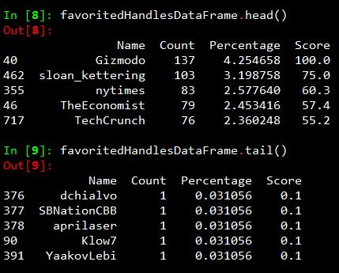
Extract the past 2 years of twitter activity (Favorites, Retweets and Mentions) for a particular Twitter Handle.
Below are screenshots of analysis on the twitter handle : “aricaroline”
Favorites
Get Search Queries
Extract Twitter Handles
Extract Retweets, Favorites and Mentions
Evaluate Score for each influencer
Aggregate the Scores and get Overall Influencers

Slide 8
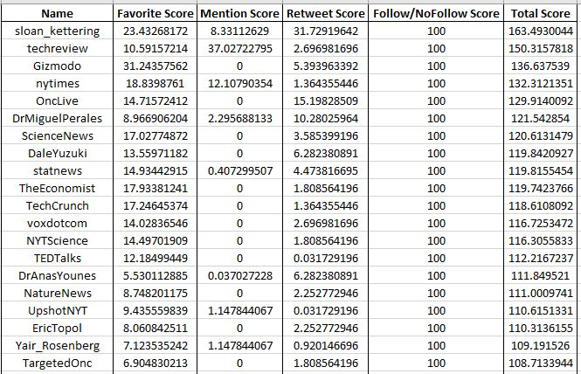
Total Score = w1 * (Favorite Score) + w2 * (Retweet Score) + w3 * (Mentions Score) + Follow/No Follow Score
Where w1 + w2 + w3 = 1
Get Search Queries
Extract Twitter Handles
Extract Retweets, Favorites and Mentions
Evaluate Score for each influencer
Aggregate the Scores and get Overall Influencers

Slide 9
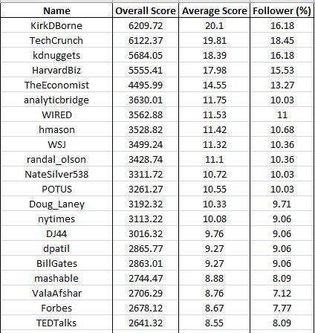
Get Search Queries
Repeat the analysis done in Step 3 and Step 4 for each twitter handle obtained using the entered keywords.
Then, aggregate the results and come up with twitter handles which can be the potential influencers to the target set as a whole.
Extract Twitter Handles
Extract Retweets, Favorites and Mentions
Evaluate Score for each influencer
Aggregate the Scores and get Overall Influencers

Slide 10
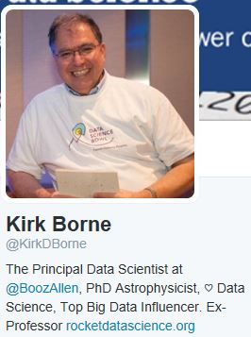
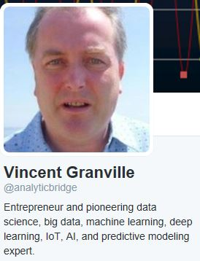
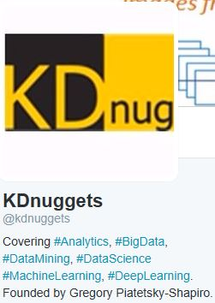
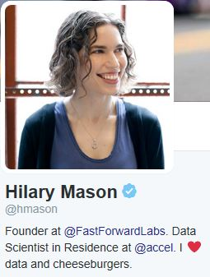
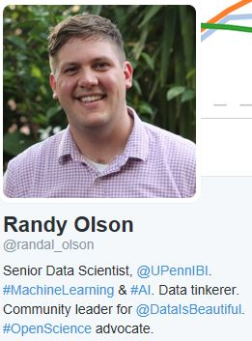
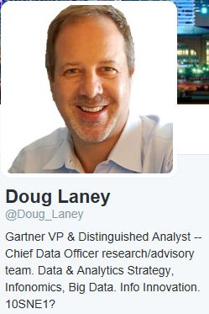
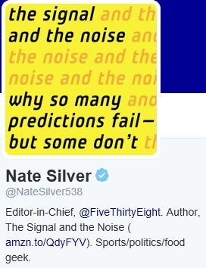
Sample Output: Top Influencers for Analytics Community

Slide 11


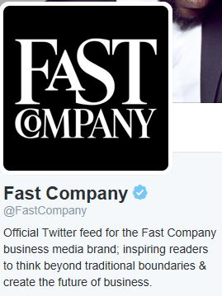

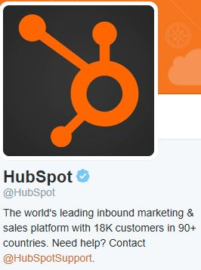

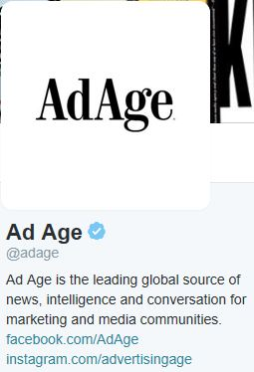
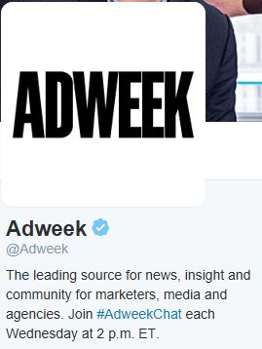
Sample Output: Top Influencers for Marketing Community

Slide 12
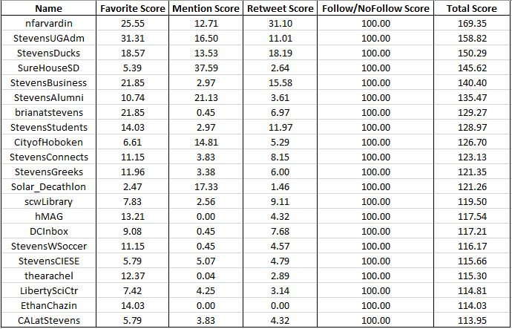
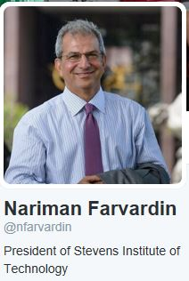


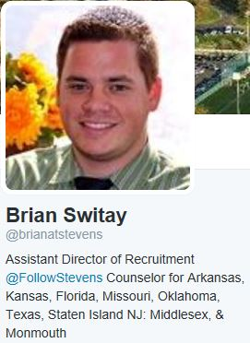
Sample Output: Top Influencers for Stevens Institute of Technology

Slide 13
Weighting Methodologies
Methodology 1 : Correlation Method
Weight of an action (Ex. Retweets) is inversely proportional to its strength of correlation with the other two actions (Favorites and Mentions).
a = 3 – (|ρ_{RT & Fav}| + |ρ_{RT & Mtn}|)
b = 3 – (|ρ_{Fav & RT}| + |ρ_{Fav & Mtn}|)
c = 3 – (|ρ_{Mtn & RT}| + |ρ_{Mtn & Fav}|)
Normalizing a, b, c, we get weights
w1 (Retweets Weight) = a / (a + b + c)
w2 (Favorites Weight) = b / (a + b + c)
w3 (Mentions Weight) = c / (a + b + c)

Slide 14
Methodology 2 : Frequency Method
The more frequent an action (retweet, favorite, mention) is, more the weight is given to it.
Let,
a = Total Number of Retweets done by a particular user b = Total Number of Favorited Posts for a particular user c = Total Number of Mentions done by a particular user
Normalizing a, b, c, we get weights
w1(Retweet Weight) = ( a / (a + b + c) ) w2(Favorite Weight) = ( b / (a + b + c) ) w3(Mention Weight) = ( c / (a + b + c) )

Slide 15
Methodology 3 : Inverse Frequency Method
The less frequent an action (retweet, favorite, mention) is, more the weight is given to it.
Let, p = Total Number of Retweets done by a particular user q = Total Number of Favorited Posts for a particular user r = Total Number of Mentions done by a particular user
Then
a = 1 - ( p / (p + q + r) ) b = 1 - ( q / (p + q + r) ) c = 1 - ( r / (p + q + r) )
The values a, b, and c are normalized to get the weights w1, w2 and w3.
w1 (Retweets weight) = a / (a + b + c) w2 (Favorites weight) = b / (a + b + c) w3 (Mentions weight) = c / (a + b + c)

Slide 16
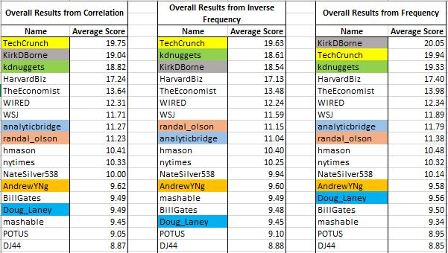
Comparison of the Overall Results

Slide 17
Assumptions
The queries which are used to extract twitter handles, are able to extract all the relevant twitter handles for the analysis.
The identified twitter handles are active and authentic.
We are considering Retweets, Favorites and Mentions as a proxy for influence.
We believe that an influencer for a particular person keeps on changing with time, which is why we analyze the past two years of data for any given twitter handle.

Slide 18
Limitations for this project
Not every person is available on twitter. This limits our target set on which the analysis is done.
There are limitations on the amount of data that can be extracted using Twitter APIs.
Identifying people at the top can be tricky as their titles can vary. So we need to search using multiple query list. This list has to be as exhaustive as possible so that we do not miss any group of people with a particular title.
Some people may not put their designation in the profile description due to compliance rules of their organization or their own choice. There is no way we can track such handles through our algorithm and hence we are unable to include them in the analysis.

Slide 19
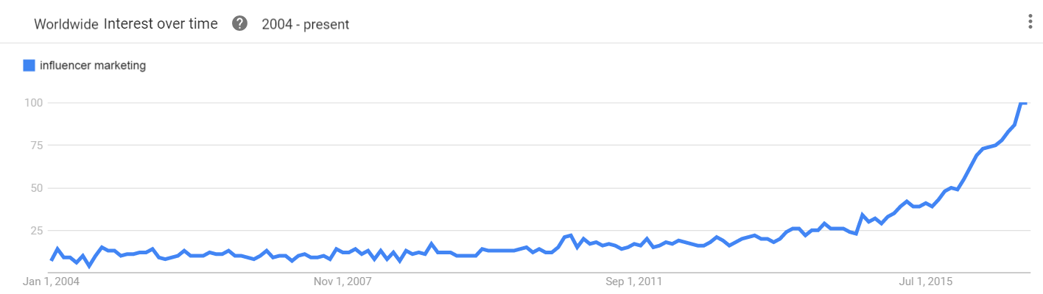
Applications of this Project
It can be a very powerful tool for companies who want to market their product.
An influencer can be invited as a keynote speaker to the corporate events of the company.
Influencers could share their expertise which can contribute to the development of the company.
Influencer marketing also helps company's search engine ranking
A look at Google Trends illustrates a burgeoning growth of influencer marketing.

Slide 20
Suggestions for Improvement
More research can be done to assign weights based on the following parameters
Number of followers
Characteristics of followers
Verified Accounts
Interaction to Tweet ratio
Twitter has added certain new features, which can also be taken into account while evaluating the weights.
Lists
Moments

Slide 21
Appendix
Scoring Scheme
Consider the following values which can be seen in the screenshot.
Maximum Percentage = 4.254658%
Minimum Percentage = 0.031056%
Maximum Possible Score = 100
Minimum Possible Score = 0.1
No. Of Bins = Maximum Possible Score / Minimum Possible Score = 100/0.1 = 1000
Width of each bin = (Maximum Percentage – Minimum Percentage) / No. Of Bins
= (4.254658 – 0.031056) / 1000 = 0.004223602%
Then assign score corresponding to the bin in which their percentage lies.
For example: A score of 100 is assigned to “Gizmodo” as its percentage lies in the 1000th bin.

Slide 22
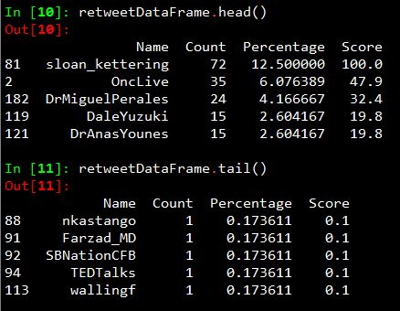
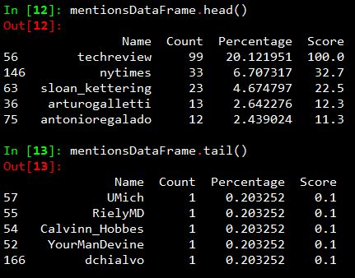
Extracting Retweets, Favorites and Mentions of the Twitter Handle
Extract the past 2 years of twitter activity (Favorites, Retweets and Mentions) for a particular Twitter Handle.
Below are screenshots of analysis on the twitter handle : “aricaroline”
Retweets Mentions

Slide 23
Questions ?

Slide 24
Thank You

